Slide 1
Lab 2

Slide 2
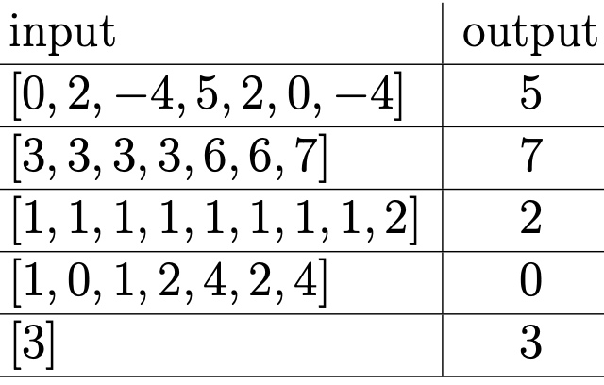
Assignment
You are given an array that consists of n ≥ 0 pairs of integers, and one unique number (total 2n+1 numbers).
a. Find the unique number using a brute force approach
b. Find the unique number for O(n) time and O(n) space
c. Find the unique number for O(n) and using no more than O(1) additional memory.
Write three methods:
a. find_unique_brute_force(arr)
b. find_unique_ON_ON(arr)
c. find_unique_ON_O1(arr)
Include driver code within your script to test these functions.

Slide 3
Submission Instructions
Submit the following in iCollege:
Python script/solution (FULL_NAME_Lab2.py)
Due date/time for submission: Within 24 hours from your lab’s end time.
Notes:
- Lab attendance is mandatory. Your iCollege submission will only be considered for grading if you attend the corresponding lab session in-person.
- If you arrive more than 20 minutes late, a 10% penalty will be applied.
- Be prepared to answer a few questions on your solution/partial solution during the lab session.

